Slide 1
Lipton thinking
Thoughts on activation for Lipton

Slide 2
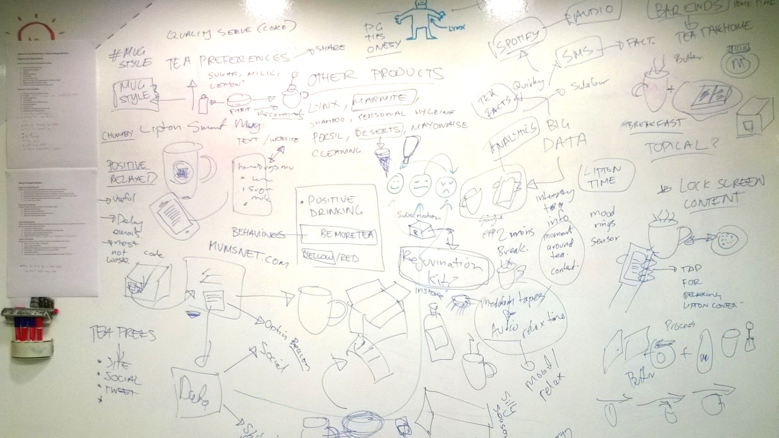
You asked us to think about tea

Slide 3
The digital biscuit
Lipton takes a leaf from Heston B

Slide 4
Insight
A cuppa is a two minute break from the rush
Tea is about defusing and recharging
Tea tastes even better with the right sounds http://condimentjunkie.co.uk/blog/2014/6/20/bittersweet-symphony

Slide 5
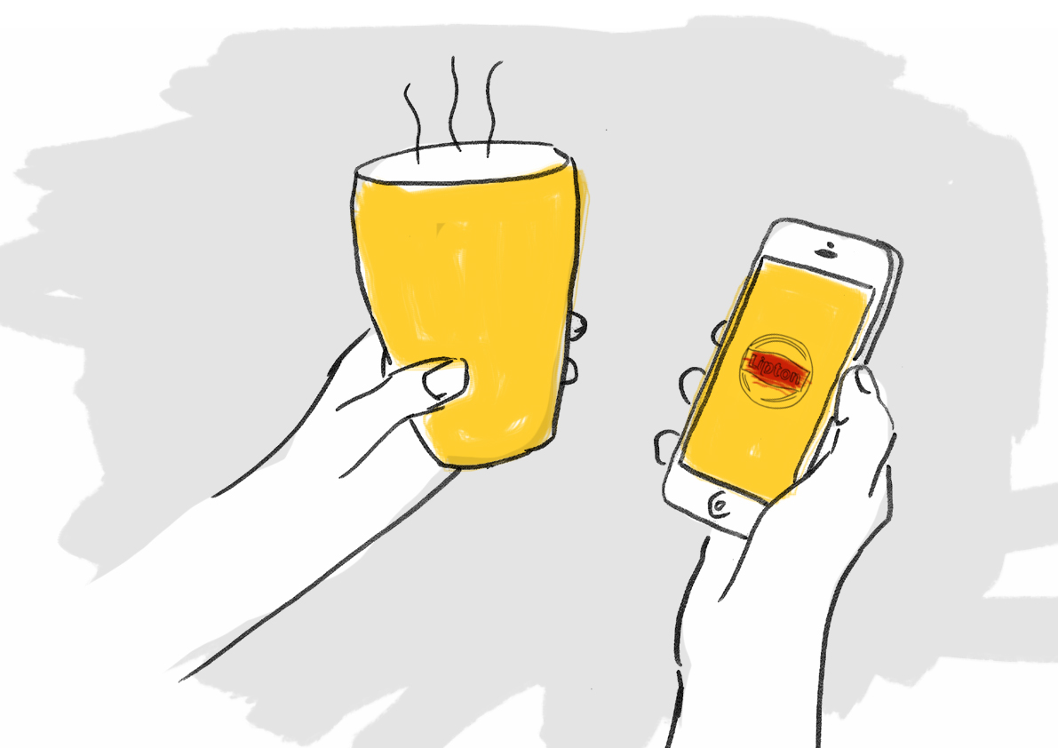
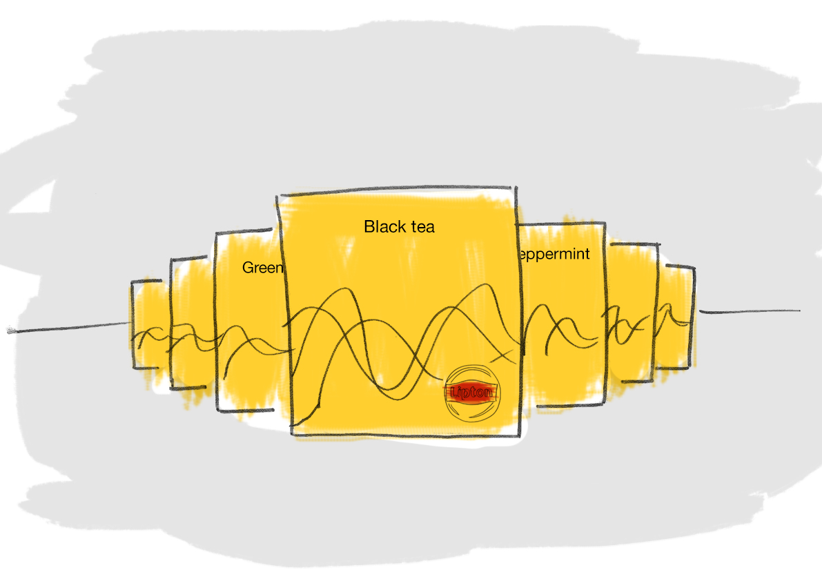
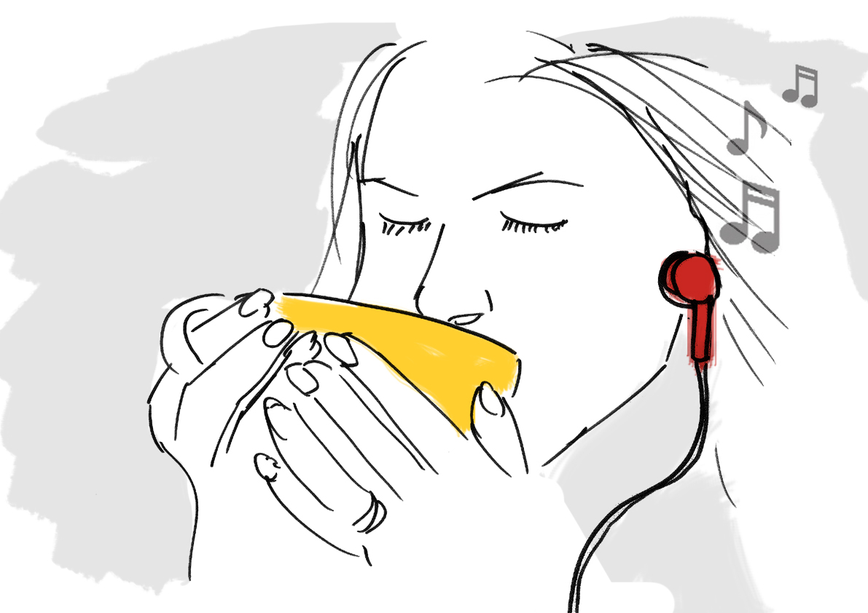
Mary taps on the biscuit icon on the lock-screen she has chosen the Liptons Spotify sound experience
For each blend of tea Heston Blumenthal has created a taste-stimulating coordinated soundscape. Mary taps on “green tea”
The digital biscuit: 2 minutes of relaxing micro-content perfection
Mary can close her eyes and enjoy the soothing feelings of happiness

Slide 6
The rejuvenate kit
Better inside and out across categories

Slide 7
Insight
Tea makes you young again
Tea defuses conflict and restores the soul
We all seek recharging experiences
Products in the personal care category deliver similar promises

Slide 8
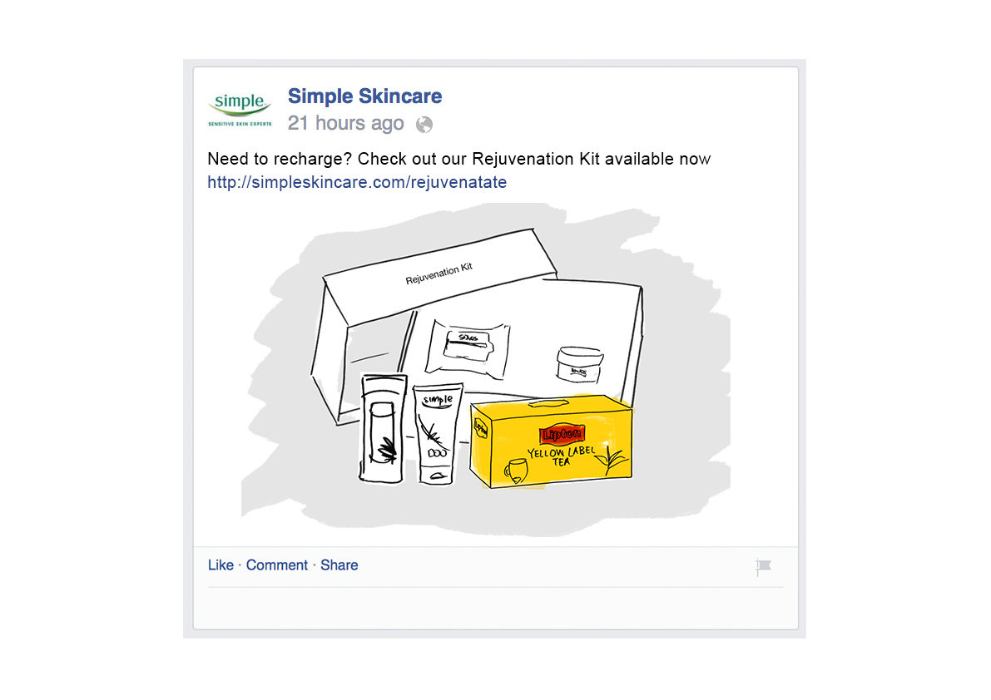
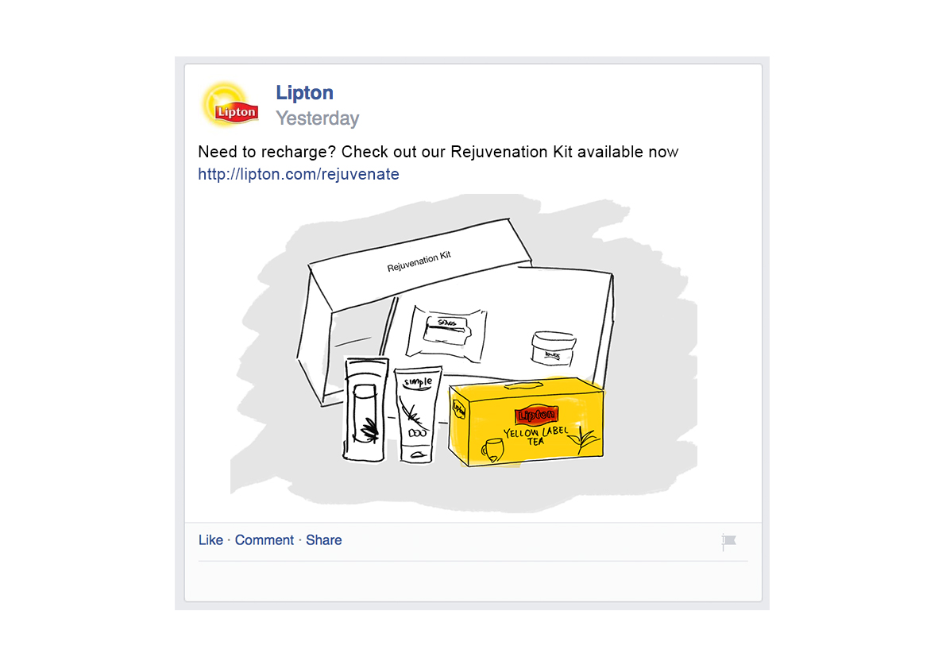
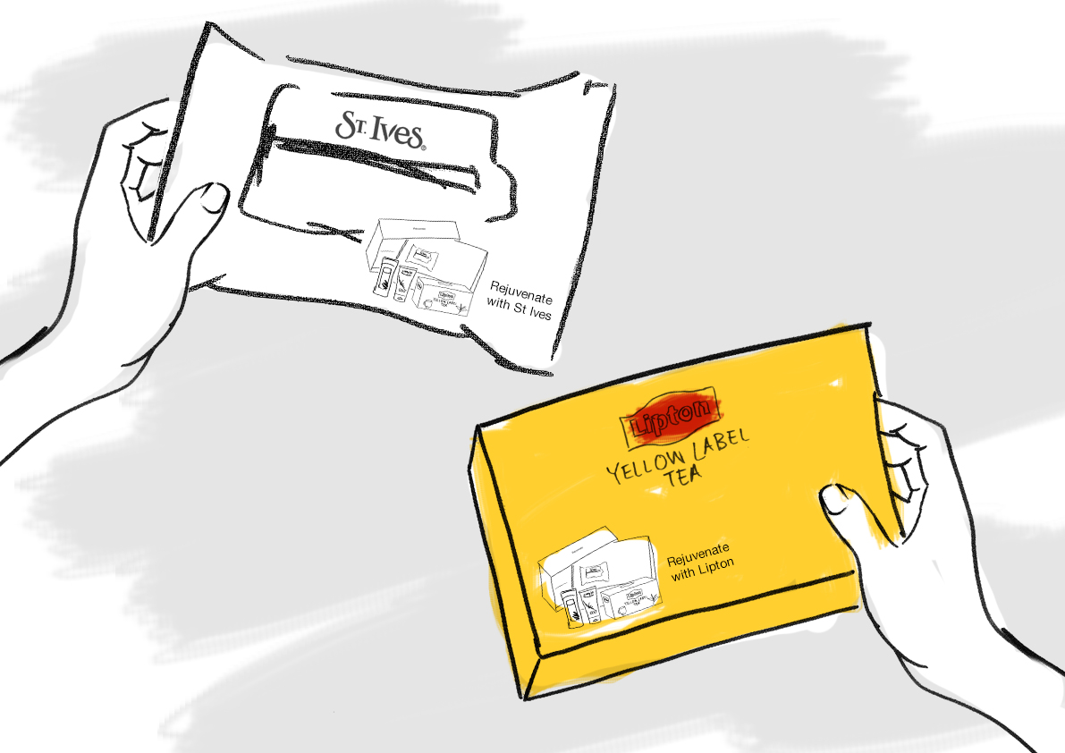
Mary follows Simple skincare on Facebook and Jaskinder follows Lipton on Twitter. They both spot an interesting offer centring on rejuvenation. The offer describes a free pack of goodies where tea and calming skin balms are packaged together.
Jaskinder looks for the display in store and buys a pack of tea (Mary might buy the simple cleanser with the same promo)

Slide 9
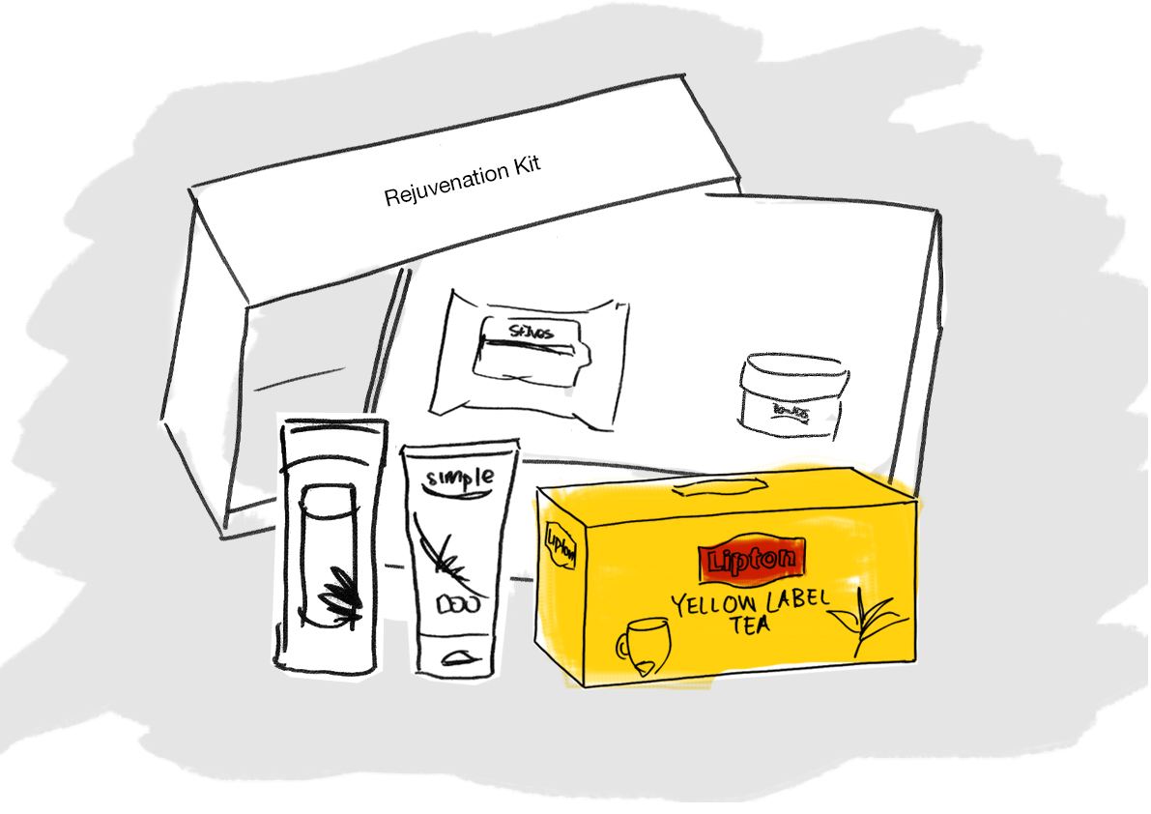
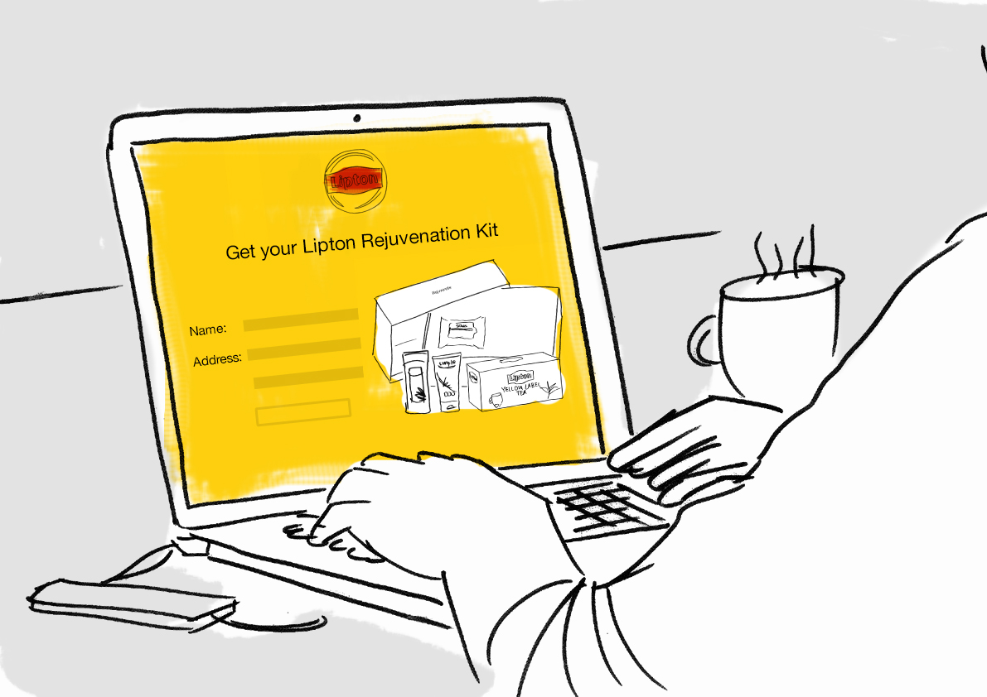
Jas sends away for the free offer and opts in to relaxing content offers
The pack arrives and Jas enjoys the rejuvenating experiences. She tells her friends about it on Facebook, closing the loop
Ae clear internally and externally Engaging withple access this knolly
Engaging withple access this knowledge and collaborate
United Utilities is a great communicator and our goals, rationale and intentions are clear internally and exteredge and collaborate

Slide 10
The smart mug™
Data-capture never tasted this right

Slide 11
Insight
I am unique and important
Respect me respect my choices
I like my tea EXACTLY like this

Slide 12
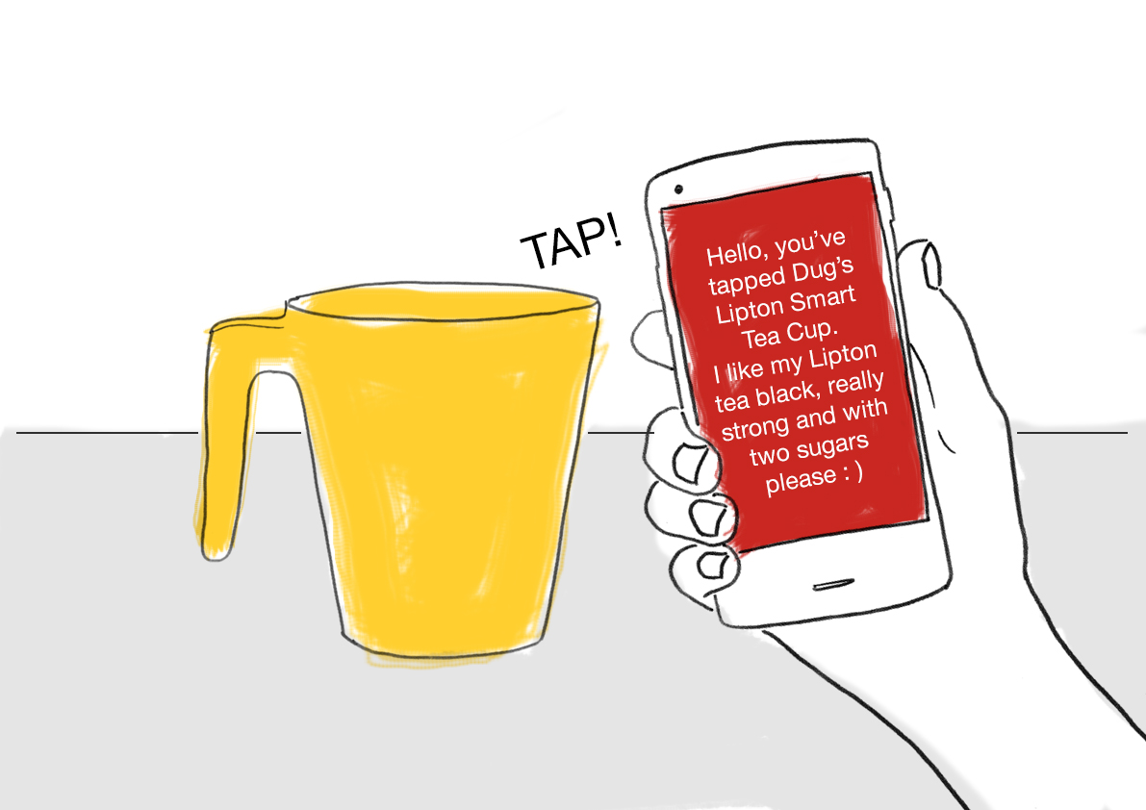
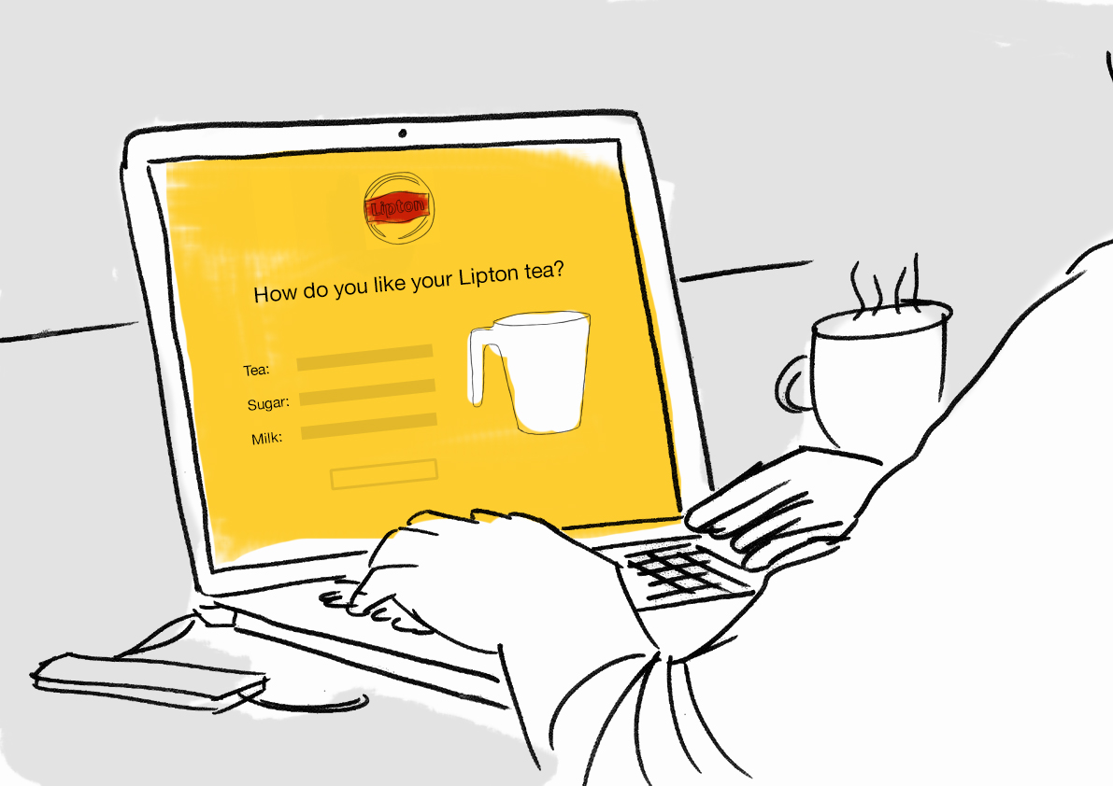
John notices promo on pack of Lipton. It’s an offer of a magic smart mug that stores the details of how you like your tea. It’s free and it sounds like fun.
When the mug arrives, John registers it online and sets his tea preferences
When John’s work colleagues make him a cuppa his mug tells them how. Tap the mug with a smartphone and the cup identifies its owner and precise tea preferences:-)

Slide 13
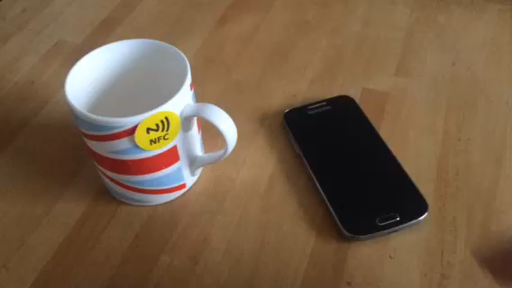

Slide 15
Thanks:-)

